Slide 1

Autonom dysreflexi
BEV COLLINS
CLINICAL NURSE LEAD,
WELLSPECT, UK
Notes:
Autonomic dysreflexa

Slide 2
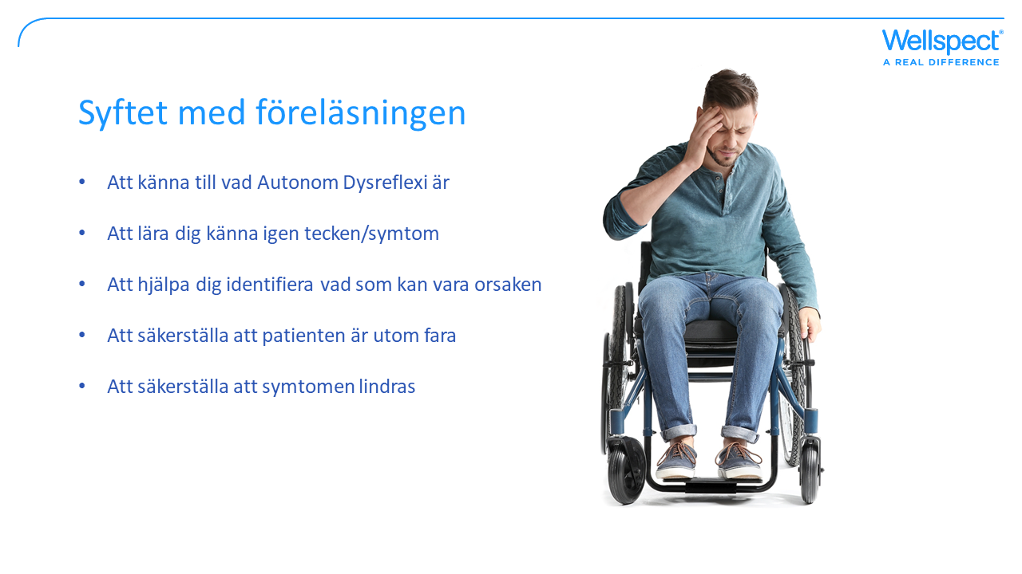
Notes:
The purpose of this session is to know what Autonomic Dysreflexia is to enable you to recognize the signs and symptoms of what Autonomic Dysreflexia, to help you to identify what may be the cause to ensure the patient is safe and obviously, this is incredibly important and ensure that symptoms are alleviated.

Slide 3
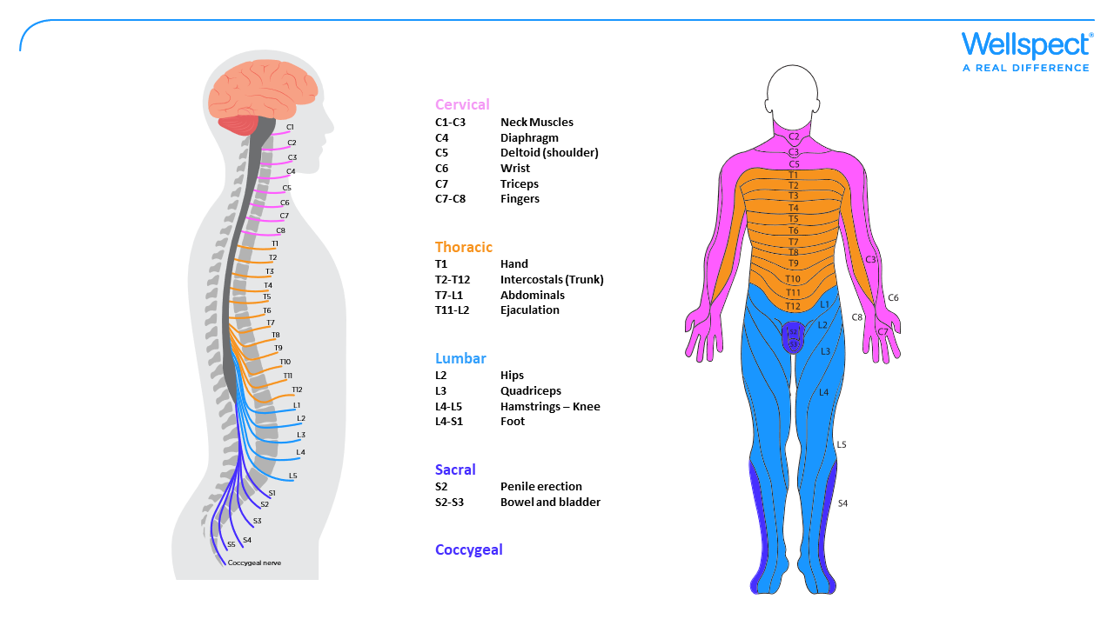
Notes:
Here is a picture of the spinal cord. At the top is the brain, and the spinal cord, and the central nervous system are identified. This allows us to mark where each level of the spinal cord will actually affect different areas of the body. If somebody does end up with some kind of injury it will give us an indication as to the possible level of their disability.
What we can also see from this picture is the sacral area, in the purpley blue colour, actually, will have an impact on both bladder and bowels. Therefore, any spinal injury, however high, or low along the level of the central nervous system, will have some kind of impact.

Slide 4
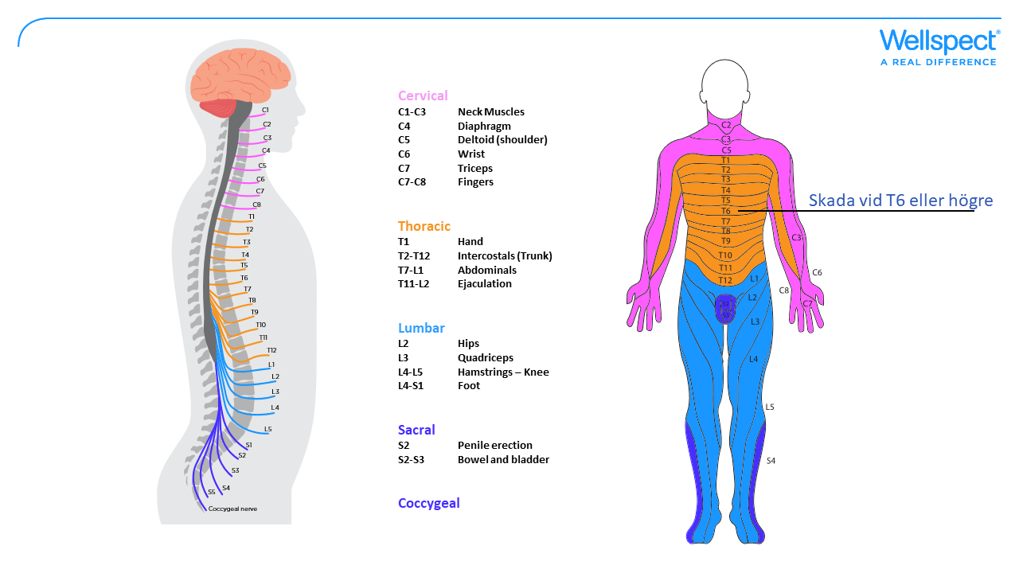
Notes:
Somebody suffering with Autonomic Dysreflexia will have a lesion at T6 or above, which allows an uninhibited sympathetic
tone causing systemic hypertension.
This basically means that the organs within the area above T6 will actually be protected by the body causing a systemic rise in the blood pressure to protect it if something is causing an issue.
Anyone with an injury at T6 or above is at risk of suffering with autonomic dysreflexia. They usually will be identified as at risk even if they've never actually suffered.
* Guillain Barre syndrome may also suffer.
Caused by immune system damaging the peripheral nervous system.

Slide 5
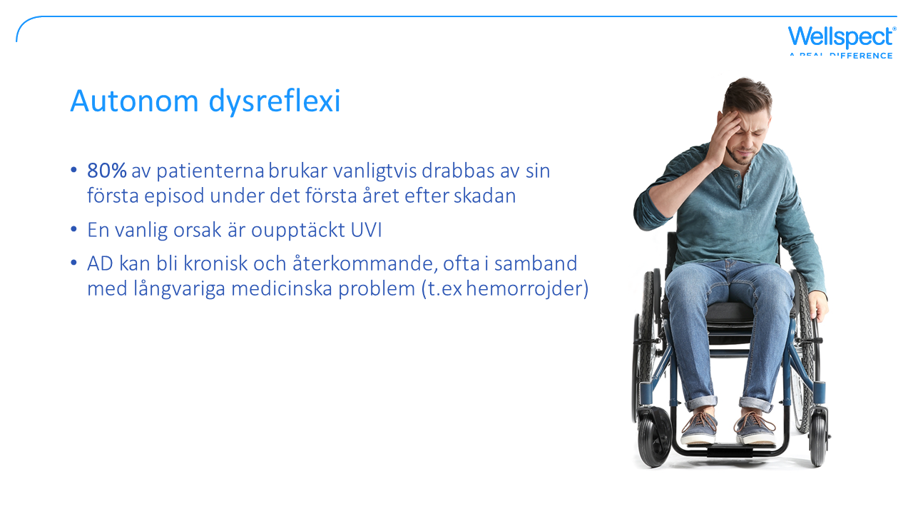
Notes:
80% of people usually experience their first episode of Autonomic Dysreflexia within their first-year post injury. And one of the most common causes of something that's hard to detect would be an undetected urinary tract infection.
Autonomic Dysreflexia can become a chronic condition and can become reoccurrent associated with long standing medical problems like haemorrhoids. We then get ourselves into a cycle of somebody who needs to have regular bowel care, or a regular bowel routine, actually having haemorrhoids.
As a result of the routine. The haemorrhoids then cause stimulation which will stimulate the autonomic response. But the haemorrhoids need to be treated before the Autonomic Dysreflexia can be reduced.

Slide 6


Notes:
Somebody with no issues whatsoever if they suffer any of the following so pain, heat, issues with the bladder or the bowel, or just the need to go to the toilet. If we find ourselves in that situation with a healthy spine and central nervous system, we would just deal with it.
So, if we touched our arm on the iron or on the oven, as we were taking something out or putting something in we would actually withdraw from the pain. We would then do what was necessary. In terms of bathing under cold water to reduce the risk and the incidence, all caused by the burn.
Bladder and bowel issues, if somebody needs to go to the toilet we would find an appropriate place and actually be able to deal with that ourselves.

Slide 7
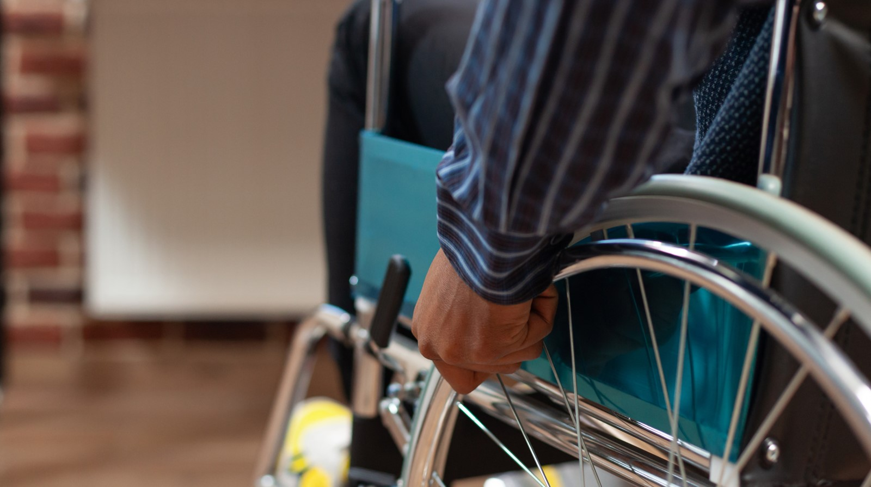
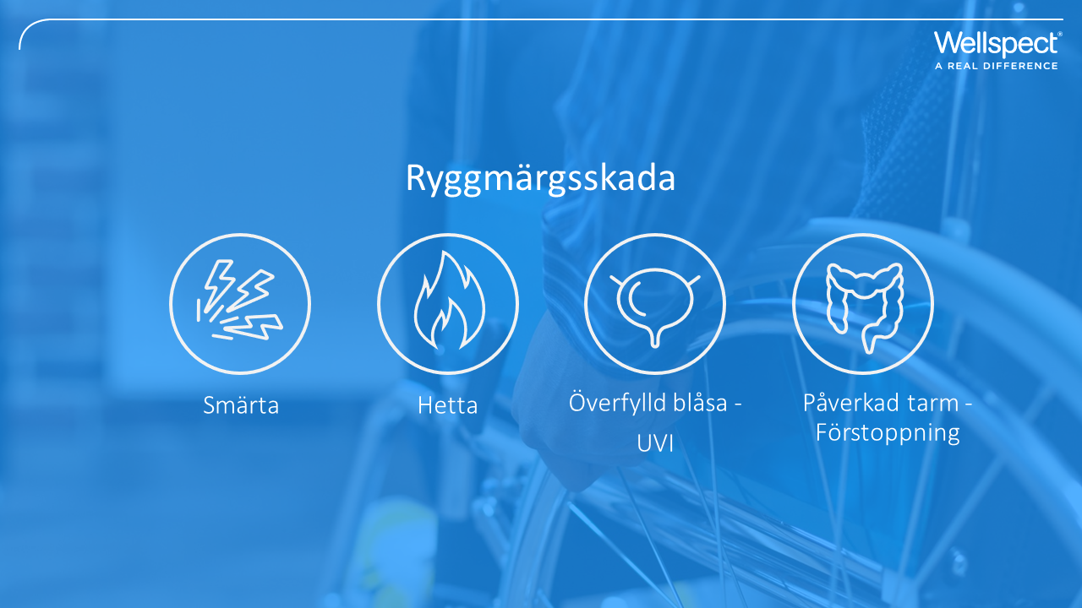
Notes:
Unfortunately, if someone has a spinal injury, if the pathways are damaged with that lesion at level T6 or above, somebody's suffering with pain, or if they're in a situation where maybe they encounter in heat, which potentially could burn them. They may not be aware of this due to the fact that they have got limited sensation due to their spinal cord injury.
Pain could be caused by many reasons, and very often somebody who suffers with Autonomic Dysreflexia may have an undetected pain caused by something related to their bladder or the bowel. Bladder irritation, maybe. Somebody is currently using intermittent catheters to empty their bladder. Maybe, a few years into their injury, become slightly displacent, and therefore are not emptying the bladder as regularly as they should be. This could actually cause the bladder to become irritated. Also, somebody with an undetected urinary tract infection.
If someone has a catheter, an indwelling catheter in situ, if potentially the tubing becomes kinked, then again, that could cause the bladder to overfill or the catheter to be unable to drain and again would cause irritation, which in turn would lead the body to try to protect itself by causing the raise in blood pressure.
Distended bowels are also something that can affect somebody and cause them to have the symptoms of autonomic dysreflexia.

Slide 8
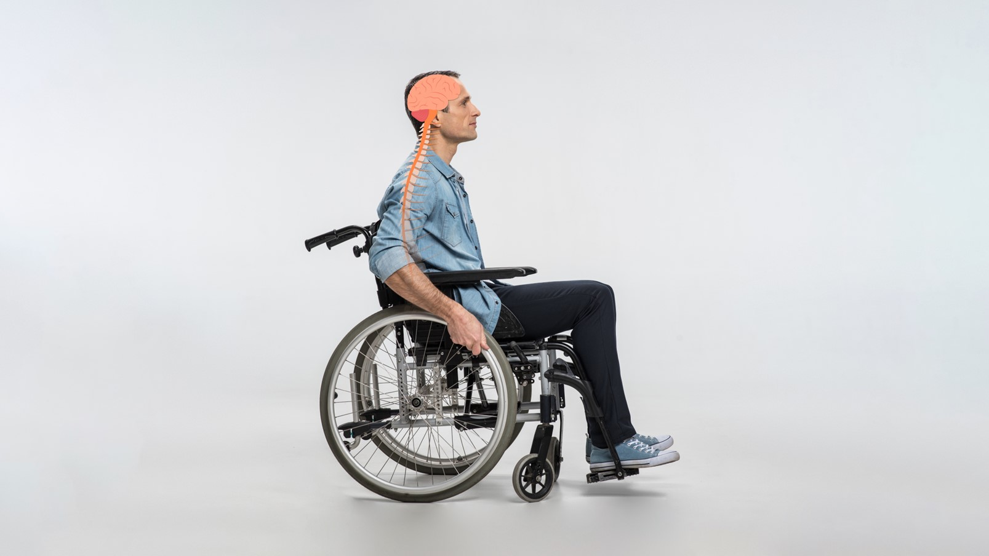
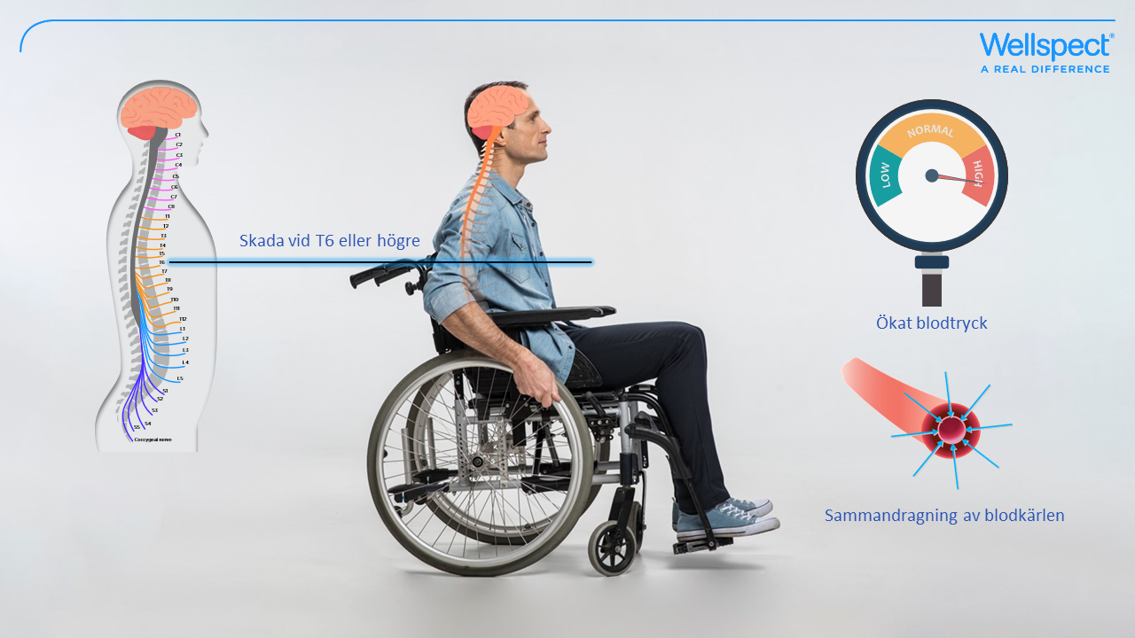
Notes:
When somebody suffers with autonomic dysreflexia, they have a sudden and potentially life-threatening rise in their blood pressure. And usually this is triggered by the pain that we've just talked about.
Potentially somebody in retention, somebody with constipation or even something like bladder stones. Infection is also another reason. It will be found in somebody with a level of T6 or above. As already mentioned, due to this sudden raise in the blood pressure, it can potentially lead to stroke, loss of consciousness, or death.
It can occur at any time and affect people who have an incomplete or a complete injury exactly the same if they're within that level. It's the body's own way of protecting itself.
A stimulation to pain, a stimulus caused, will cause the dilation of the blood pressure.
The blood pressure will start to rise due to the dilation of the blood vessels, and with a normal intact central nervous system, we will be able to regulate the pressure at the same time allow us to move away from the stimulus.
So as referenced earlier, if it was something heat related, possibly a burn, we would feel the pain, remove ourselves from it, and in turn, our body would automatically regulate the blood pressure.
In somebody with a spinal cord injury at level T6 and above, the stimulus is not always cognitively felt, so they may not be aware of the pain, and therefore will not move away from it. So, this is the body's own way of protecting itself.

Slide 9
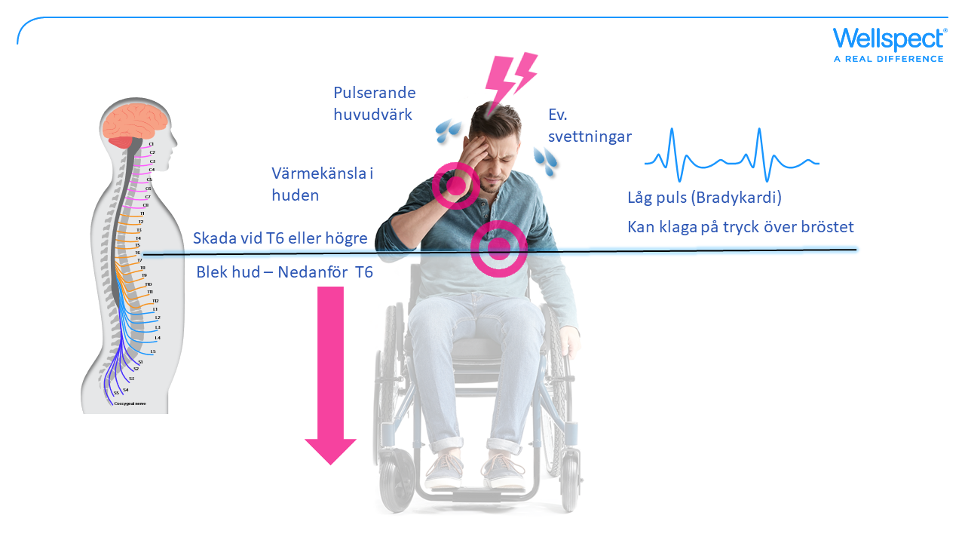
Notes:
The symptoms and the warning signs would be the client having a frontal pounding headache. They may become flushed in their skin and they may sweat. But if you look at the level below the injury, what you'll see is that the skin is very pale.
They may complain of a tight chest, but the interesting fact is that they have a slow pulse rate, so they have a bradycardia. The key thing is to find and remove this stimulus.

Slide 10
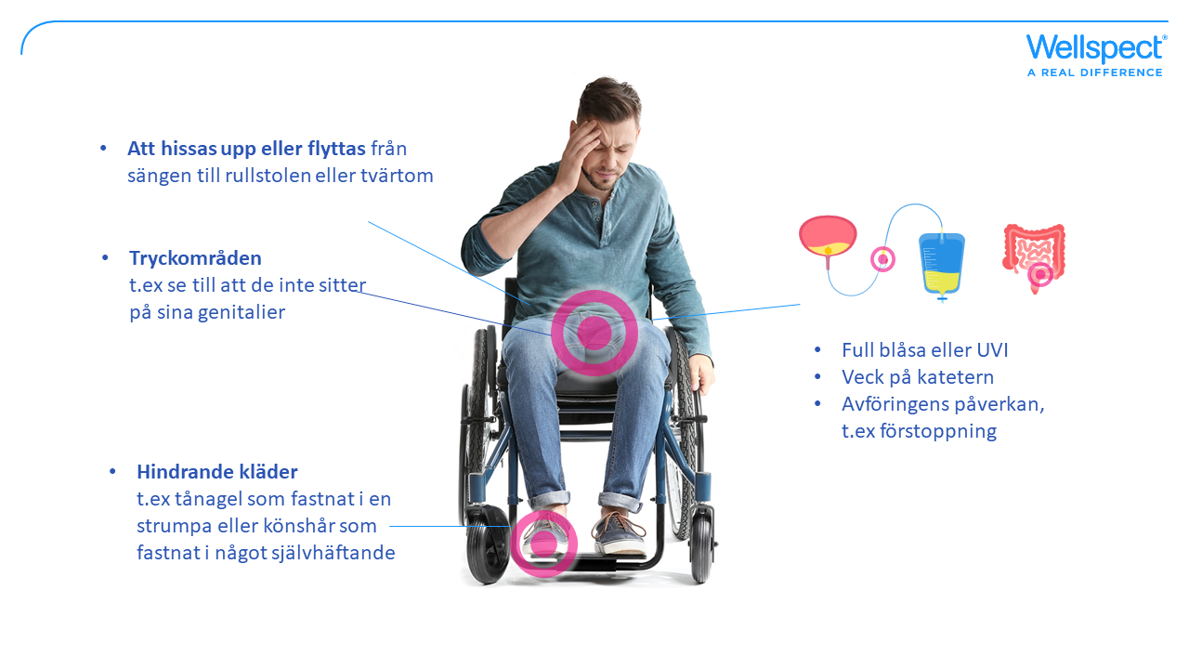
Notes:
As far as the treatment process goes, as I've just said, We need to remove the stimulus. It is very important to actually think what could be causing this. And a really good way of dealing with it is obviously think about the most obvious thing and the client themselves may already know what that is. So, it may well be that there's a kink in the catheter.
It may well be that they know that the bladder is getting over full. But it may also be something quite simple like a toenail stuck in a sock which is inside their shoe. If you or I, without any injury felt that discomfort, we would take our shoe off, remove the sock from the toenail and put our shoe back on and it would be fine. But if you have no sensation, then they are unable to actually tell us what it potentially is that's causing it.
Some other things just to consider is if it's a gentleman wearing a penile sheath, if it's self-adhesive, the adhesive could have a pubic hair stuck in it, which in turn could be causing pain. That's unfelt. In the same way a lady using any kind of sanitary protection, if she's wearing a sanitary towel, the sticky tab on the back of that could also have pubic hair attached to it, which in turn could be causing pain.
These are quite basic things, but can actually have the consequence of an Autonomic Dysreflexia attack. Another thing is if someone is being hoisted and being moved from maybe their bed into their wheelchair, or in the opposite way. It's also important, particularly for a gentleman to ensure that his genitalia is not being sat on because again, that could cause pain for them.

Slide 11

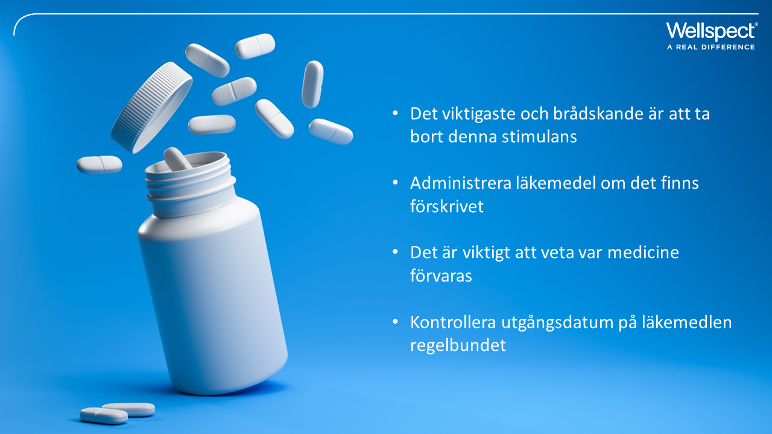
Notes:
The important thing and the urgency is to remove that stimulus. Administer medication if prescribed and most people who suffer with Autonomic Dysreflexia will have the medication prescribed. It's important to know where the medication is kept. And it's also important that we check regularly the dates on the medication, as it's something that the majority of people isn't used very regularly. The medication prescribed would be an antihypertensive or a vasodilator. Nephedopine is very often used in an immediate release form.

Slide 12
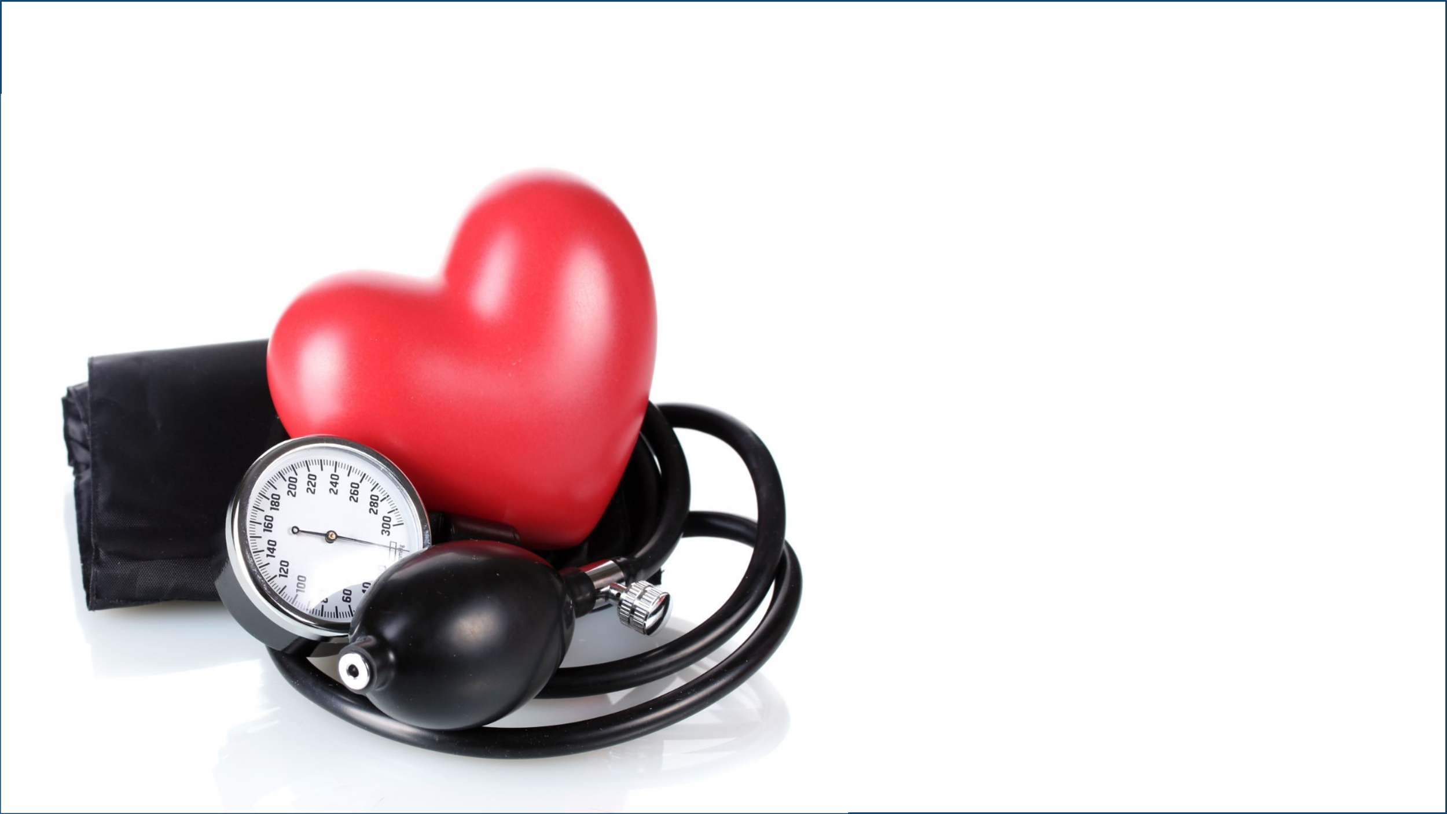
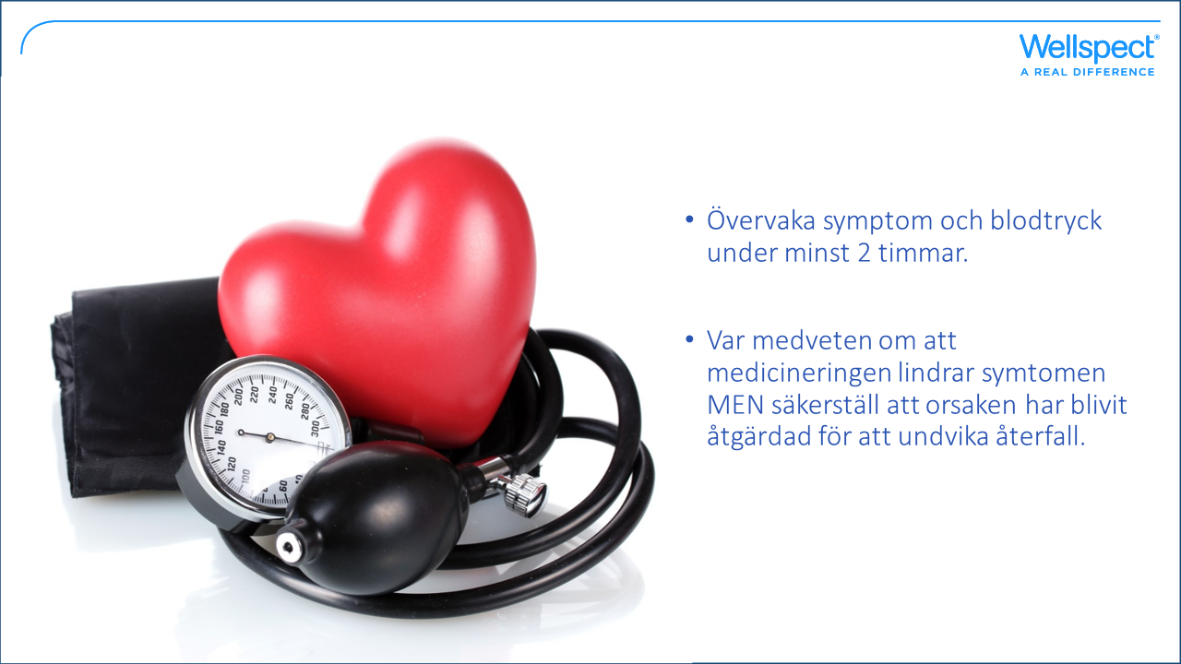
Notes:
Once you have administered the medication, it's important post the Autonomic Dysreflexia symptoms is to monitor the blood pressure for at least 2 hours.
People who suffer in this category may well have carers who live with them or family, who will be able to do this and just cheque that the blood pressure has become stabilised.
It's important to remember that medication relieving the symptoms will actually reduce the blood pressure, but if we haven't actually removed the stimulus completely, we could expect a reoccurrence of the symptoms.

Slide 13
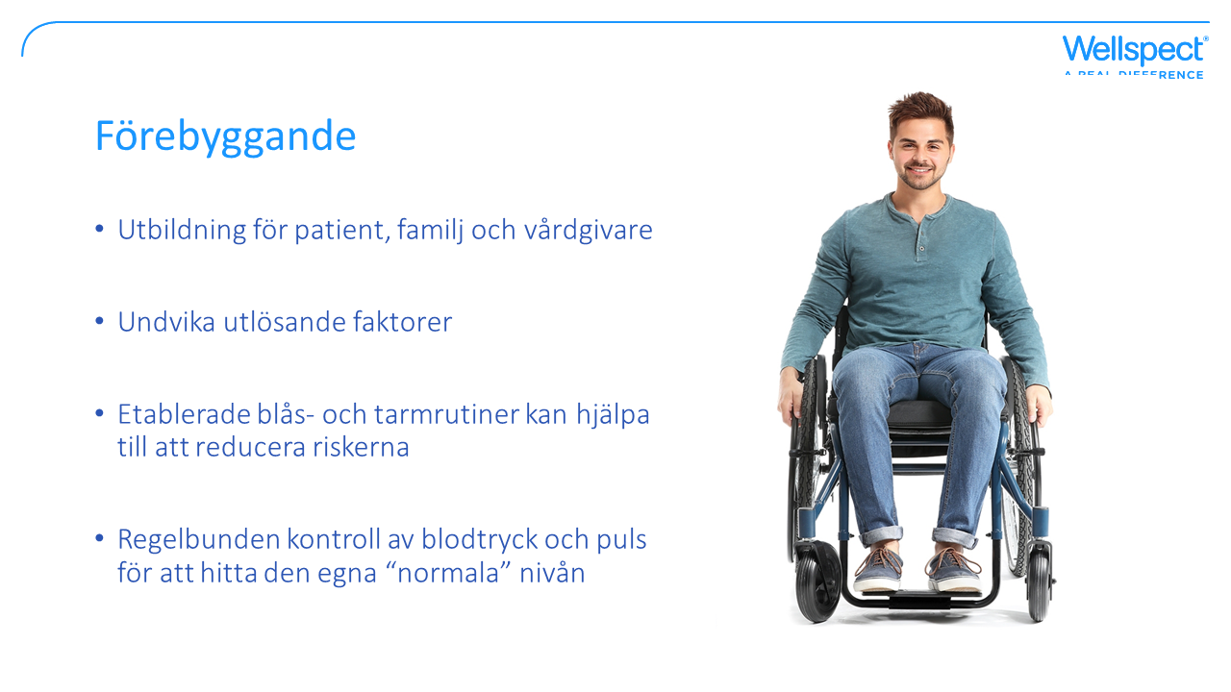
Notes:
Prevention is probably one of the main things that will assist us with somebody who is at risk with autonomic Dysreflexia and education. For patients, the family and the caregivers is really important. It would be a good idea wherever possible to avoid the triggers that may cause an attack.
Somebody having an established bladder and bowel routine will actually help us to reduce the risks associated with Autonomic Dysreflexia because we know that anyone who is in this risk category may well have issues with bladder and bowel care.
Also importantly, regular checking and recording of the blood pressure and pulse to establish someone's normal range will also enable you to establish if someone is actually becoming more at risk during their Autonomic Dysreflexia attack. So, it would be a good idea maybe once checking the medication regularly, also to do a regular BP and pulse recording within their own patient records.
Thank you.

